Slide 1
Linking Lower Guadalupe River Club Repeaters
Calhoun county: 147.020 - W5KTC/R PDN to SADRC
Victoria county: 443.800 - W5DSC/380 PDN to SADRC
Dewitt county: 146.640 - W5DWT/R PDN to SADRC
Victoria county: 145.13 0 - W5DSC/513 Local Digital Conf Room

Slide 2
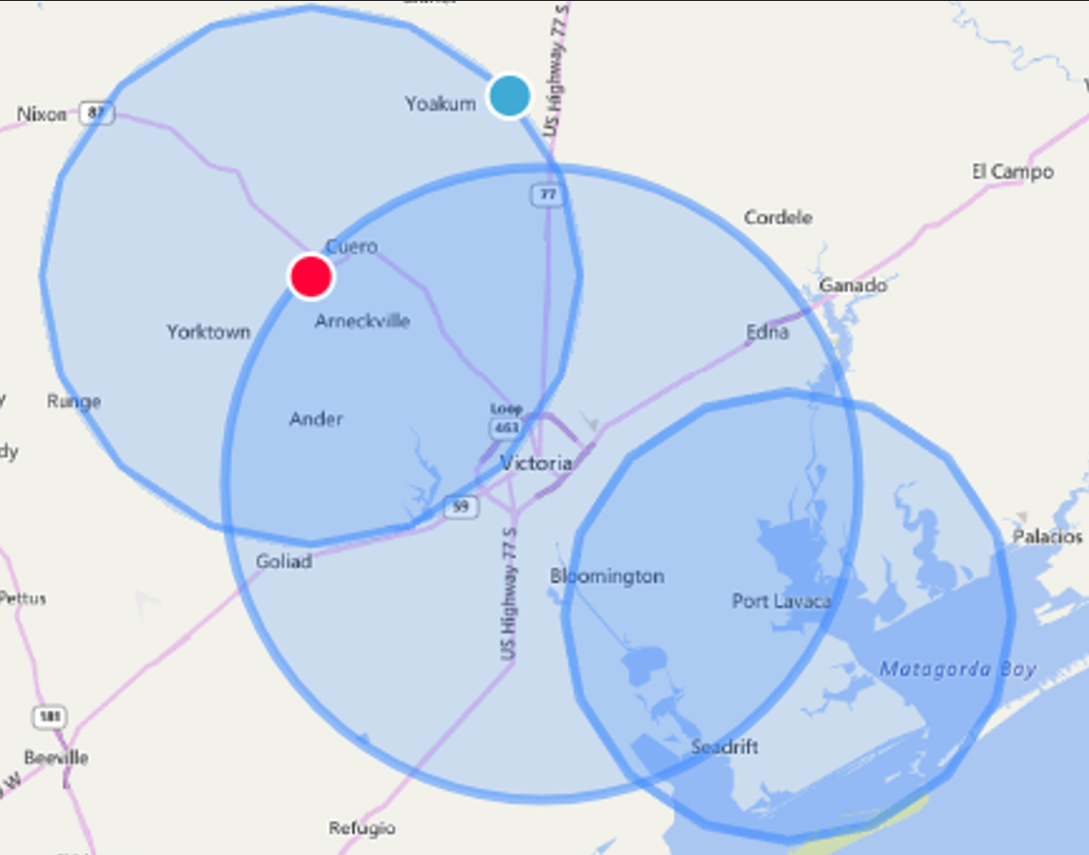
Lower Guadalupe River Coverage 146.64 / 443.80 / 147.02 with new FUSION repeaters installed in 2024

Slide 3
Clubs’ Repeaters’ History Since Hurricane Harvey
Since Hurricane Harvey:
Move to harden repeater locations or harden existing locations
Secured, Weather Hardened, Emergency Power, & Accessibility
Cost effectively refurbished, retuned or replaced critical repeaters systems
Including antenna’s, feedlines, and duplexers
Deploy new technology if appropriate
Selected Fusion digital technology
Refurbished the strongest repeater, 145.19, as analog only
Cause no harm nor pressure hams to migrate now
To the new features and technology
And the migration is at each ham’s desired pace (or NOT).
Analog users gain some additional range (but not as much as digital)
Facilitated by FUSION Automatic Mode Selection (AMS) feature

Slide 4
Why Link Lower Guadalupe River Repeaters? 146.64 / 443.80 / 147.02 with new FUSION repeaters installed in 2024
Continuous coverage from bay at Port Lavaca along evacuation routes beyond Cuero.
Linkage with Corpus Christi NWS. Corpus Christie and Port Lavaca are our weather canaries.
Regional linkage to Austin (GOV, FEMA, RACES, ARES).
Continuous (almost) link from New Braunfels to Seadrift along Guadalupe River. (Think TX Water Safari).
Increase repeater usage. They are extremely underutilized now.
Knowledge sharing, because we Hams like to tinker!
BUT ONLY DIGITAL MODE TRAFFIC IS LINKED!

Slide 5
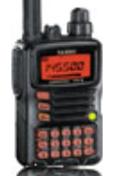
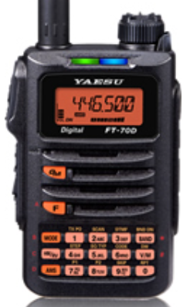
I Heard that Digital is Hard to Learn and Use!
Which one is analog only?

Slide 6
Migration to Fusion Digital is Easy
Feature Yaesu VX-7 (analog) Yaesu FT70DR (AMS) Anytone DMR HT
Size Similar Similar Larger
CHIRP programmable Yes Yes No
Easy to manually pgm Yes Yes NO!
Power On Time 1 second 1 second 9 seconds
Memories 129 900 4000
Cost $200+ (Used) $175 $165 (new model)
It is simple to get started. Easy to manually program. Or take the export from VX-7 from CHIRP (free) and imported it to FT70DR. Only need to check a box for each of the Yaesu repeaters to activate the digital option!
Reminder from earlier talks this year, that you can continue to use your analog radio with your local repeater. BUT only Digital communications will be linked to other repeaters.
FYI: I share accessories between my 20+ year old VX-7 with the FT70DR!

Slide 7
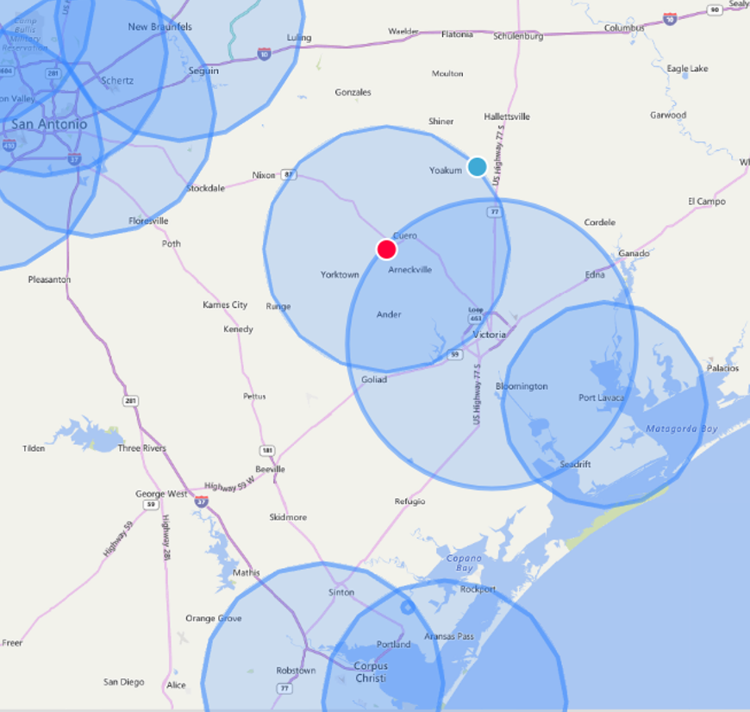
SE San Antonio Coverage Linked to SADRC
HOW IS LINKAGE TO SADRC MADE?
One repeater per club/county has a Portable Digital Node (PDN) attached to it that facilitates linkage to the San Antonio Digital Radio Club network (SADRC) via the internet. (“Points” to SADRC.)
Each repeater owner / trustee keeps autonomy of their repeater and controls their link.
WHAT ABOUT W5DSC/513?
W5DSC/513 repeater (145.13) is configured as a local/regional Conference Room so other PDN’s can connect (point) to it.
INTERNET NOTES:
Each repeater will continue to automatically operate even if their internet link goes down.
Citizen’s Medical Center (443.800) has priority internet service.

Slide 8
What’s a PDN? What’s a Conference Room?
Portable Digital Node (PDN)
A Portable Digital Node adds two components to the repeater:
Windows 10/11 PC with processor clock speed of 2.0GHz or greater
C4FM digital transceiver
Think “Pointing Directly” node, as it can link (point) to only one connection point at a time.
No special internet requirements are needed! (Even worked with my cell phone hotspot!)
Confennce Room (WIRES-X Room)?
A WIRES-X Conference Room adds two components to the repeater:
Windows 10/11 PC with processor clock speed of 2.0GHz or greater
HRI-200 interface kit
Think “Conference Calls”, as one to many PDN’s can connect to it.
Special internet requirements are needed for the HRI-200, such as fixed or dynamic global IP address, and special configuration of internet ports. (Almost impossible to get these requirements from hospitals and government facilities.)

Slide 9
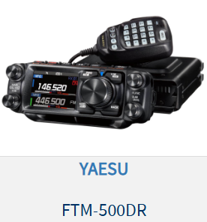
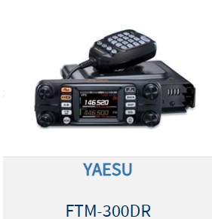
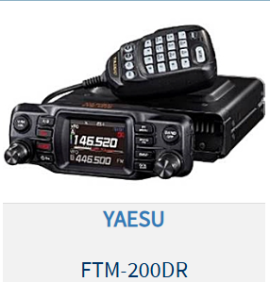
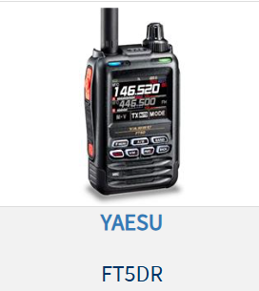
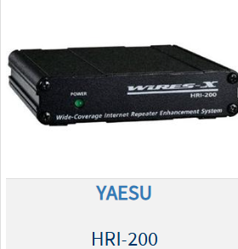
C4FM digital transceivers and HRI-200
Radios (above) are PDN capable radios
HRI-200 WIRES-X Interface Kit
(Left)

Slide 10
Configuration of the 146.64 / 443.80 / and 147.02 Repeaters Portable Digital Nodes
DR2 Repeater, FTM-200DR PDN/transceiver and Windows computer
D U
P L X R
REPEATER
DR-2X
(PS, Rx, Tx, Cntlr)
LOCAL NODE
FTM-200DR
WIN 10/11 PC
Connected
To Internet
SADRC
Via Internet

Slide 11
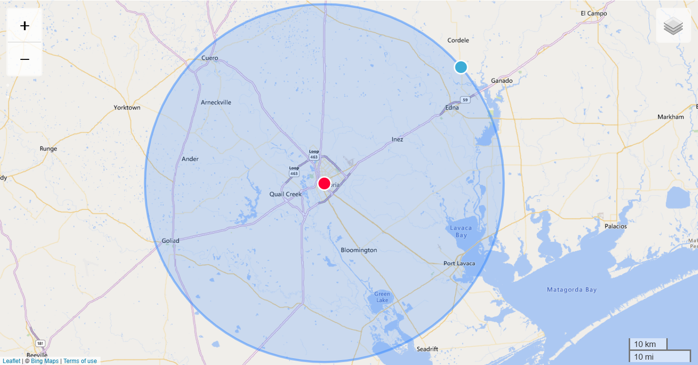
Victoria – W5DSC 145.13 Hosts Local Conference Room!
NEW! BONUS!
Not originally in scope!
Unused equipment, loaned equipment, and the initiative by Bob (KG5JWX), made this a reality!
It was conceived, planned and implemented, all just in this week!
Being monitored for issues.
Best use practices and procedures are still evolving.
Local Conference Room will provide short-term, logical linkage of nodes and rooms for special events and communications.
Notes: KG5JWX has emergency power, and high-speed fiber optics internet will be installed within the next 30 days!

Slide 12
Configuration for the 145.13 Repeater Conference Room
DR2 Repeater, FTM-200DR PDN/Transceiver, HRI-200 Interface, and Windows computer
D U
P L X R
REPEATER
DR-2X
(PS, Rx, Tx, Cntlr)
LOCAL NODE
FTM-200DR
WIN 10/11 PC
Connected
To Internet
Internet Interface
HRI-200
Internet

Slide 13
Victoria – W5DSC 145.19 Refurbished and will Remain Analog

Slide 14
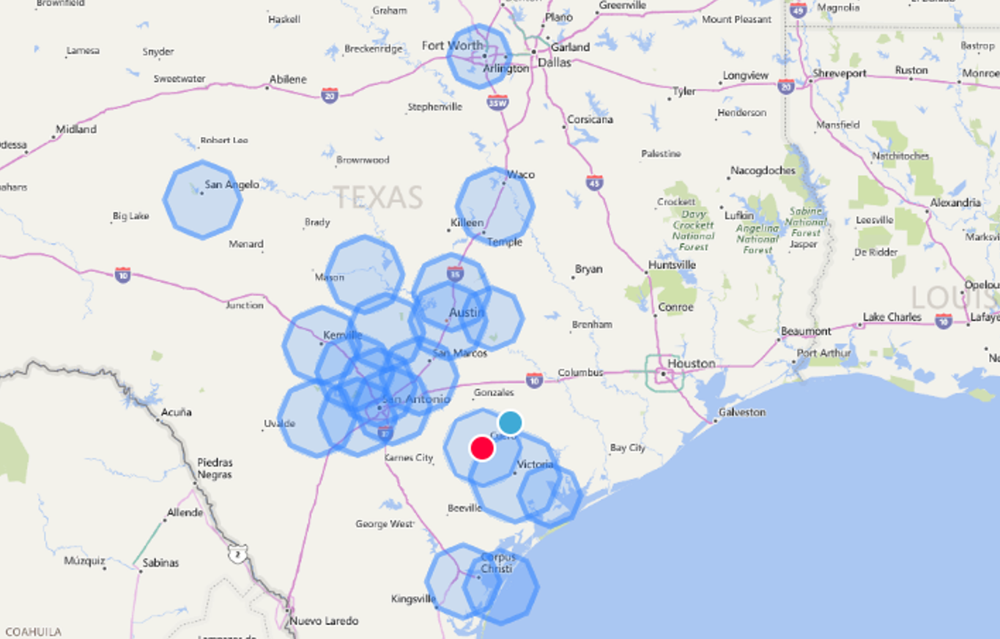
SADRC FUSION Linked Repeaters
Growing FUSION coverage, but surprisingly not too busy! About 40% of the digital repeaters in TX are FUSION.
Looking for opportunities to fill in gaps in the SE SA region. (Know any repeater operators in these areas that might want to go FUSION?)
Wealth of knowledge and sources that are freely shared.
NOTE: ONLY FUSION Digital goes across the SADRC link. (No Analog.)

Slide 15
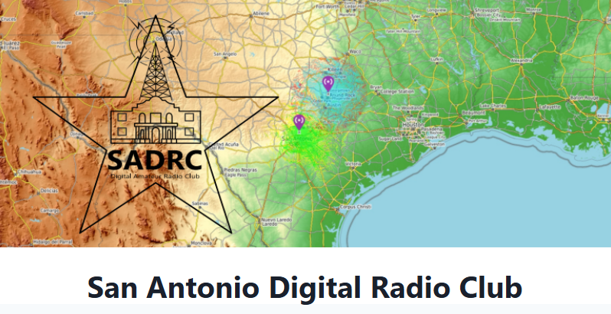
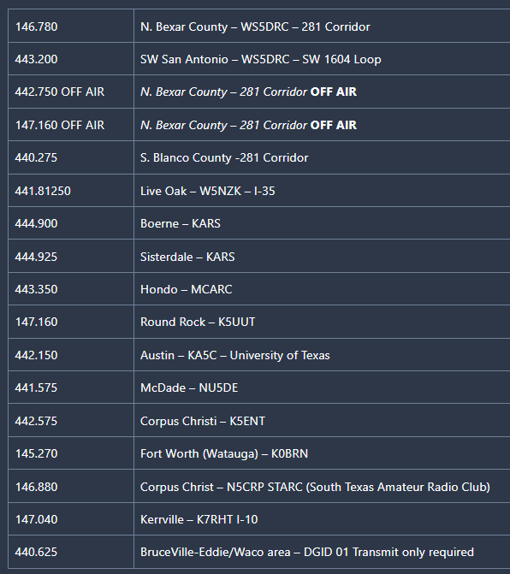
SADRC FUSION Linked Repeaters List
San Antonio Digital Radio Club (sadrc.net)

Slide 16
Linking Lower Guadalupe River Club Repeaters
Calhoun county: 147.020 - W5KTC/R PDN to SADRC
Victoria county: 443.800 - W5DSC/380 PDN to SADRC
Dewitt county: 146.640 - W5DWT/R PDN to SADRC
Victoria county: 145.13 0 - W5DSC/513 Local Digital Conf Room
QUESTIONS?
COMMENTS?

